Slide 1
VIRTUAL REALITY GRAPH VISUALISATIOM
KEYAN SADEGHI NAMAGHI

Slide 2

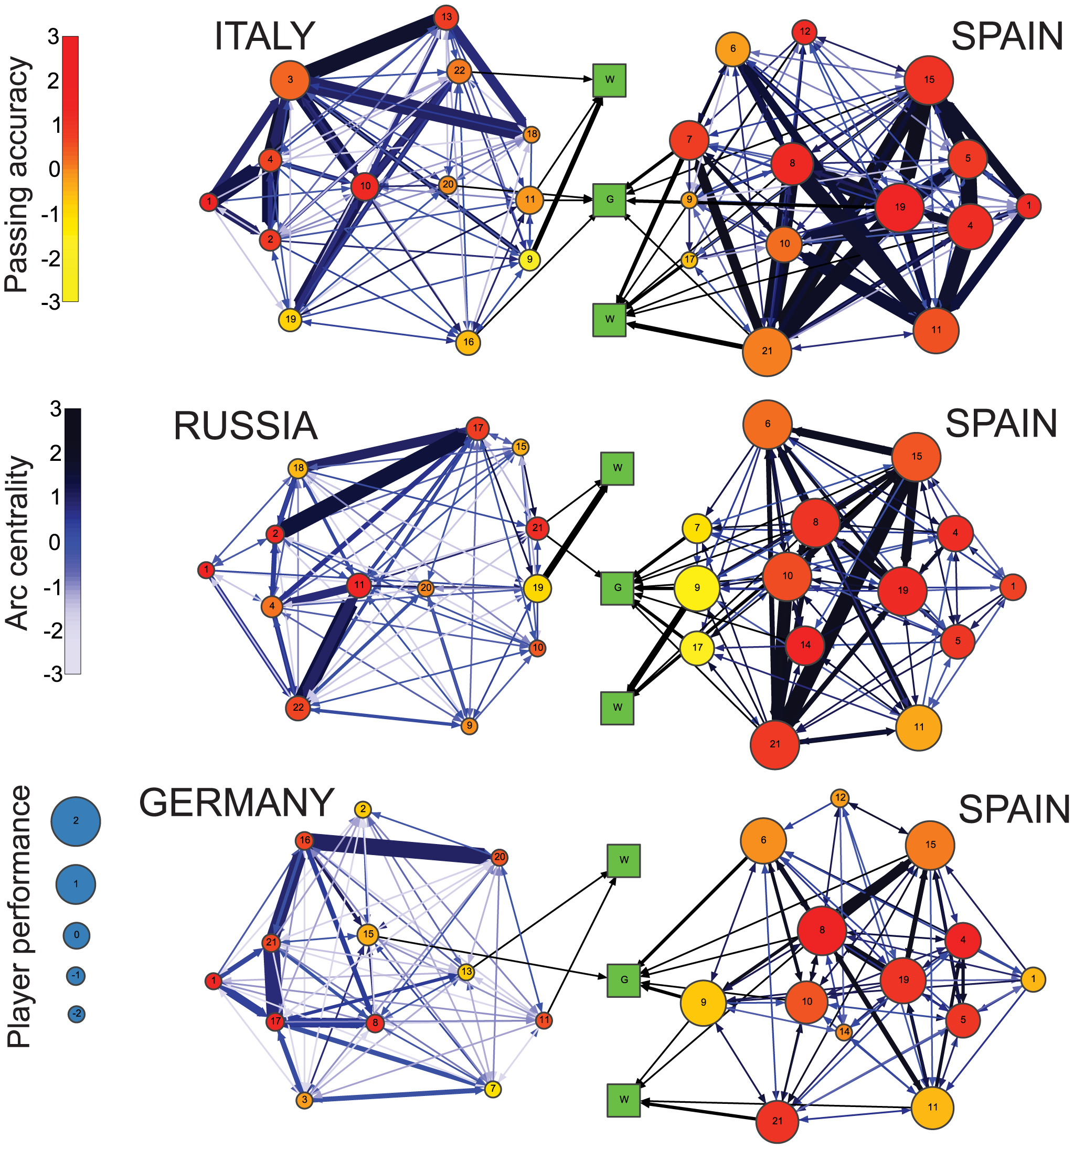
WHAT ARE GRAPHS?
Duch, J., Waitzman, J. S., & Amaral, L. A. N. (2010). Quantifying the performance of individual players in a team activity. PloS one, 5(6), e10937.

Slide 3
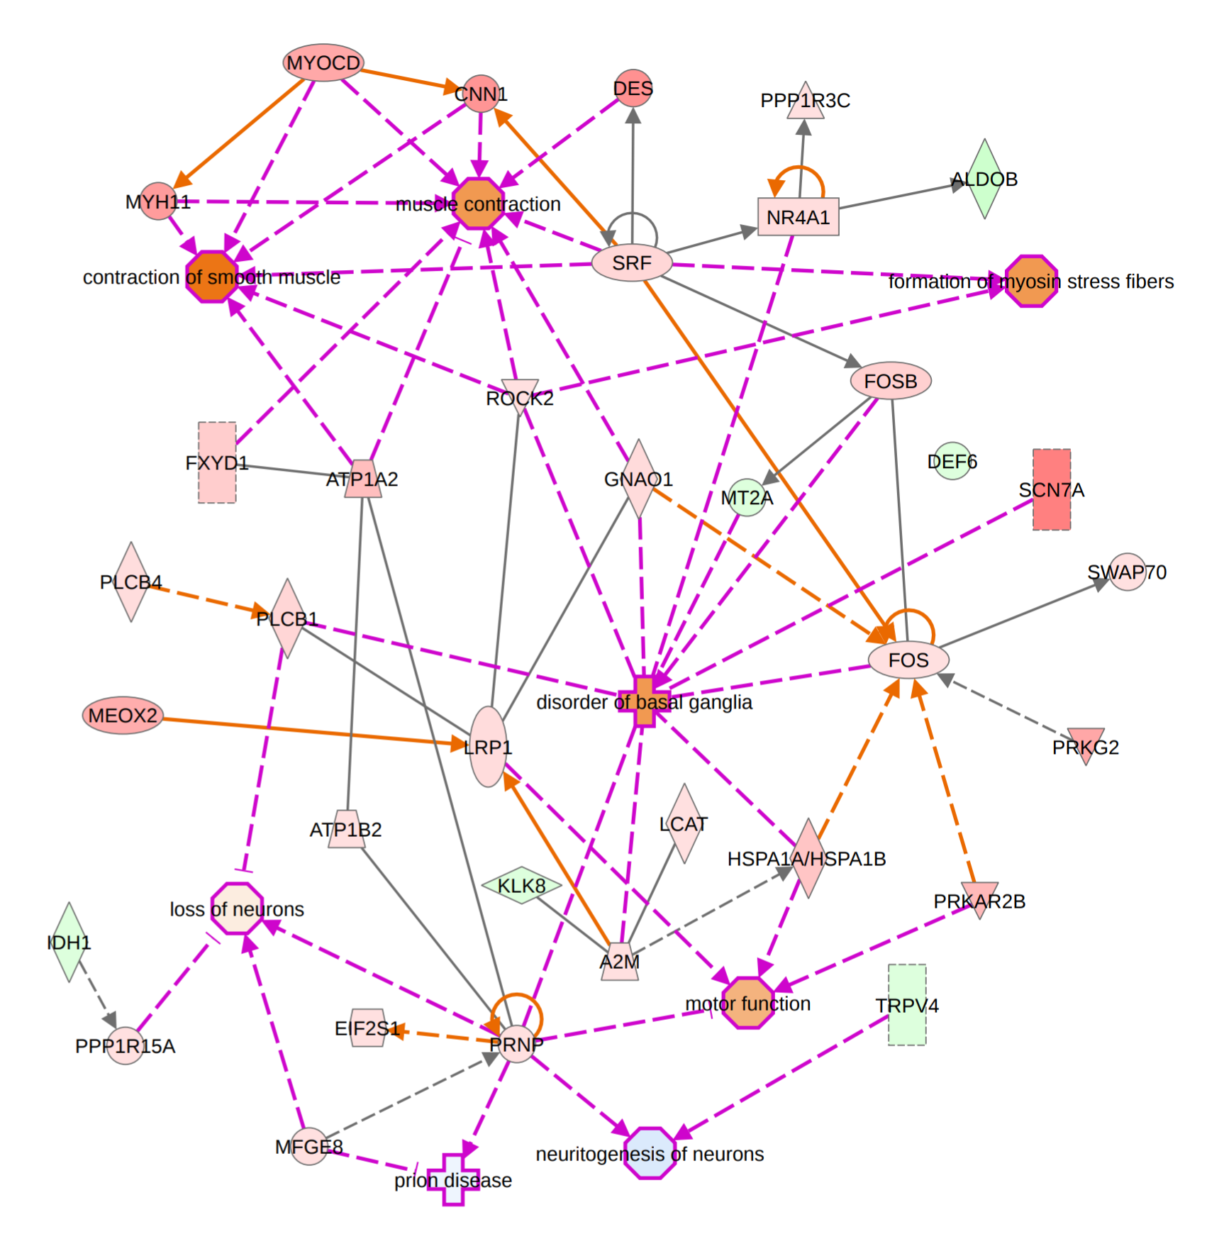
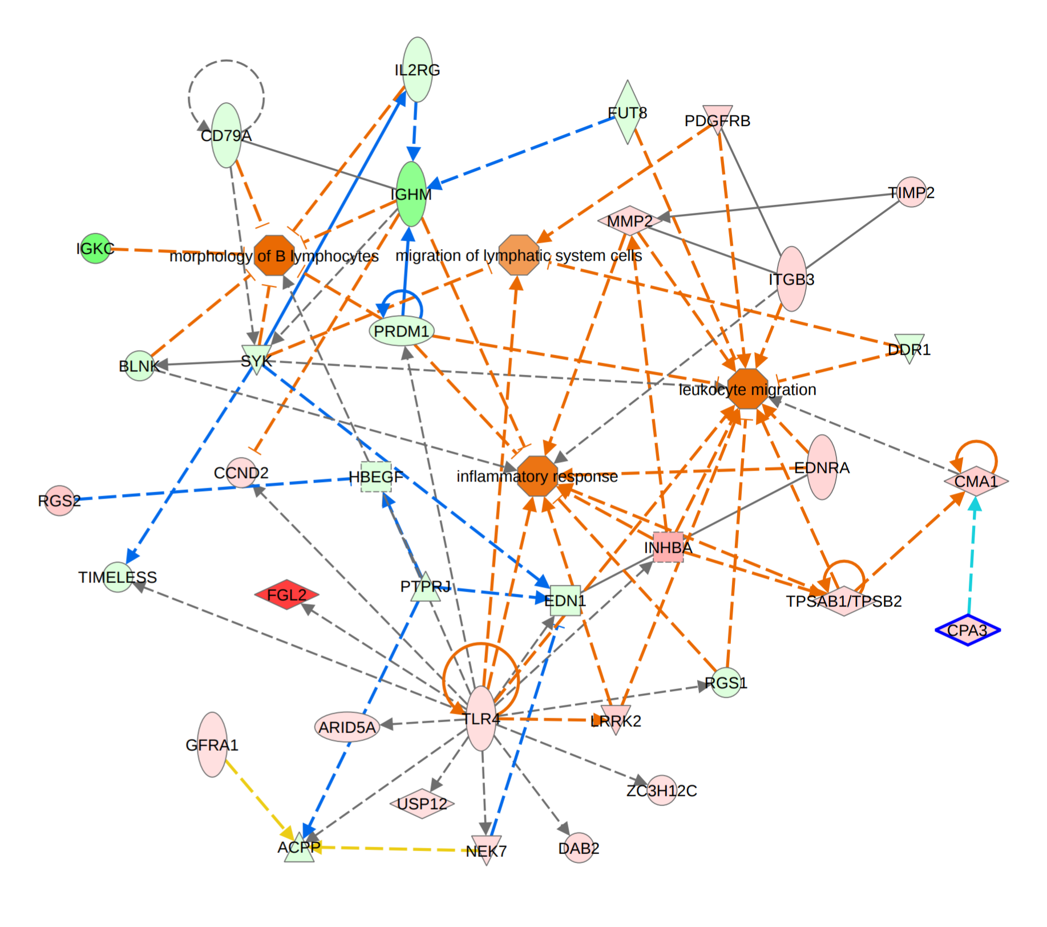
PROBLEMS WITH CONVENTIONAL GRAPHS
Palmieri, O (2016). Gene expression of muscular and neuronal pathways is cooperatively dysregulated in patients with idiopathic achalasia. Scientific reports, 6, 31549.

Slide 4
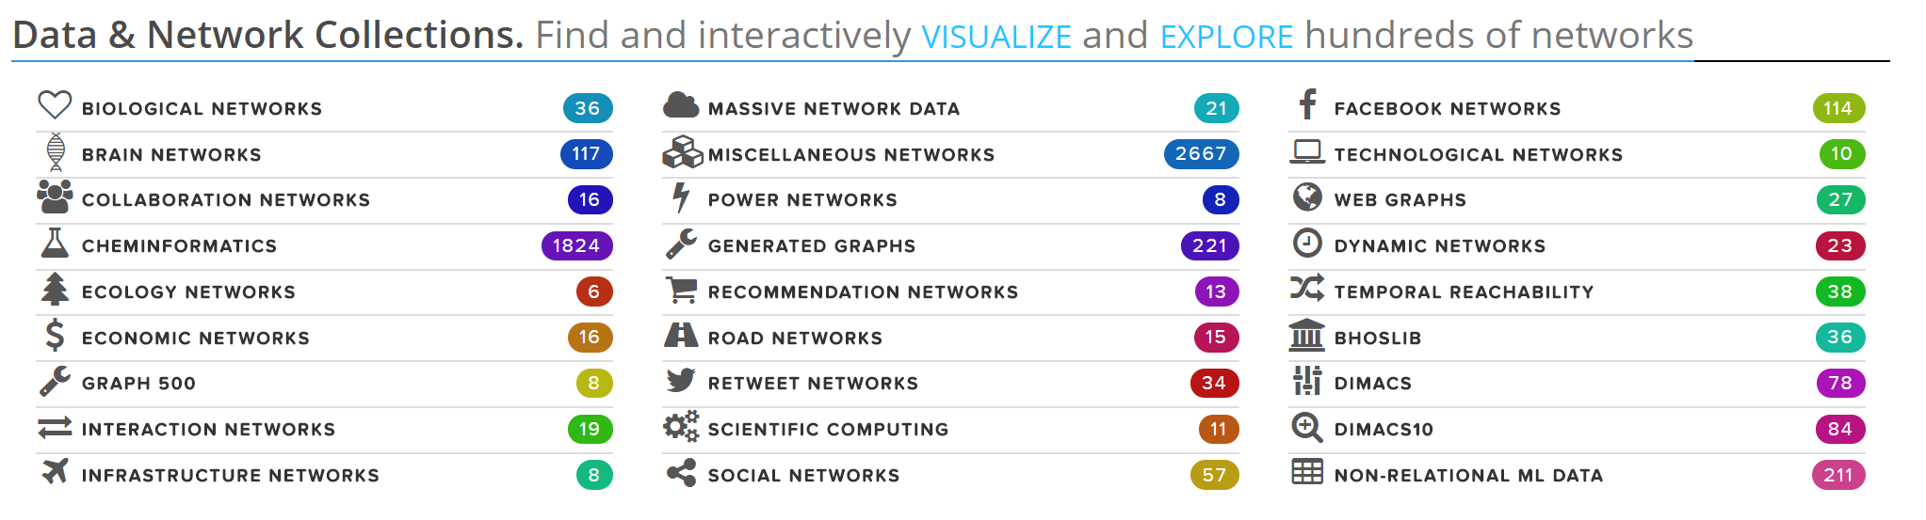

USES FOR GRAPHS
http://networkrepository.com

Slide 5
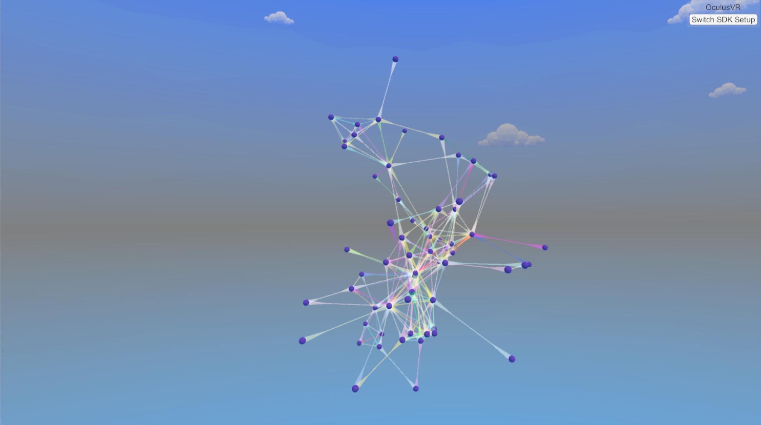
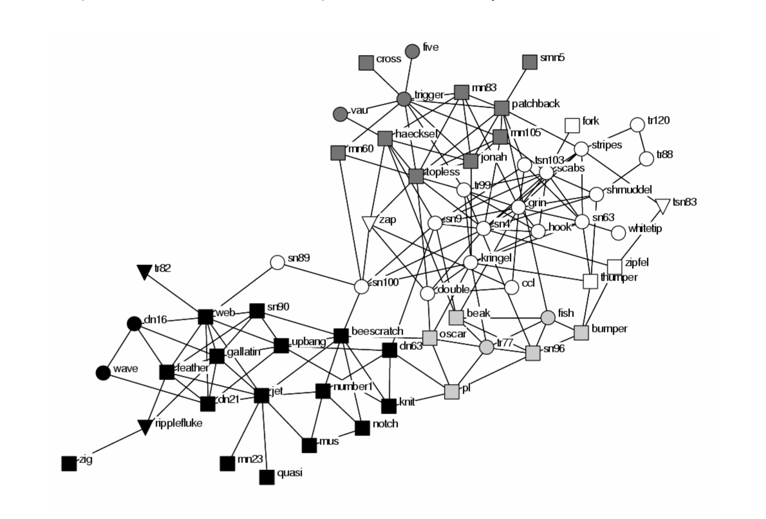
Lusseau, D., & Newman, M. E. (2004). Identifying the role that animals play in their social networks. Proceedings of the Royal Society of London B: Biological Sciences, 271(Suppl 6), S477-S481.

Slide 6
CAPABILITIES
GENERAL PURPOSE GRAPH CONTROLS
THROUGH RADIAL CONTROLS
ADD NODE
CONNECT NODES WITH LINKS
HIDE NODE
INSPECT NODE
SHORTEST PATH
NODE PROPERTY CHANGER

Slide 7
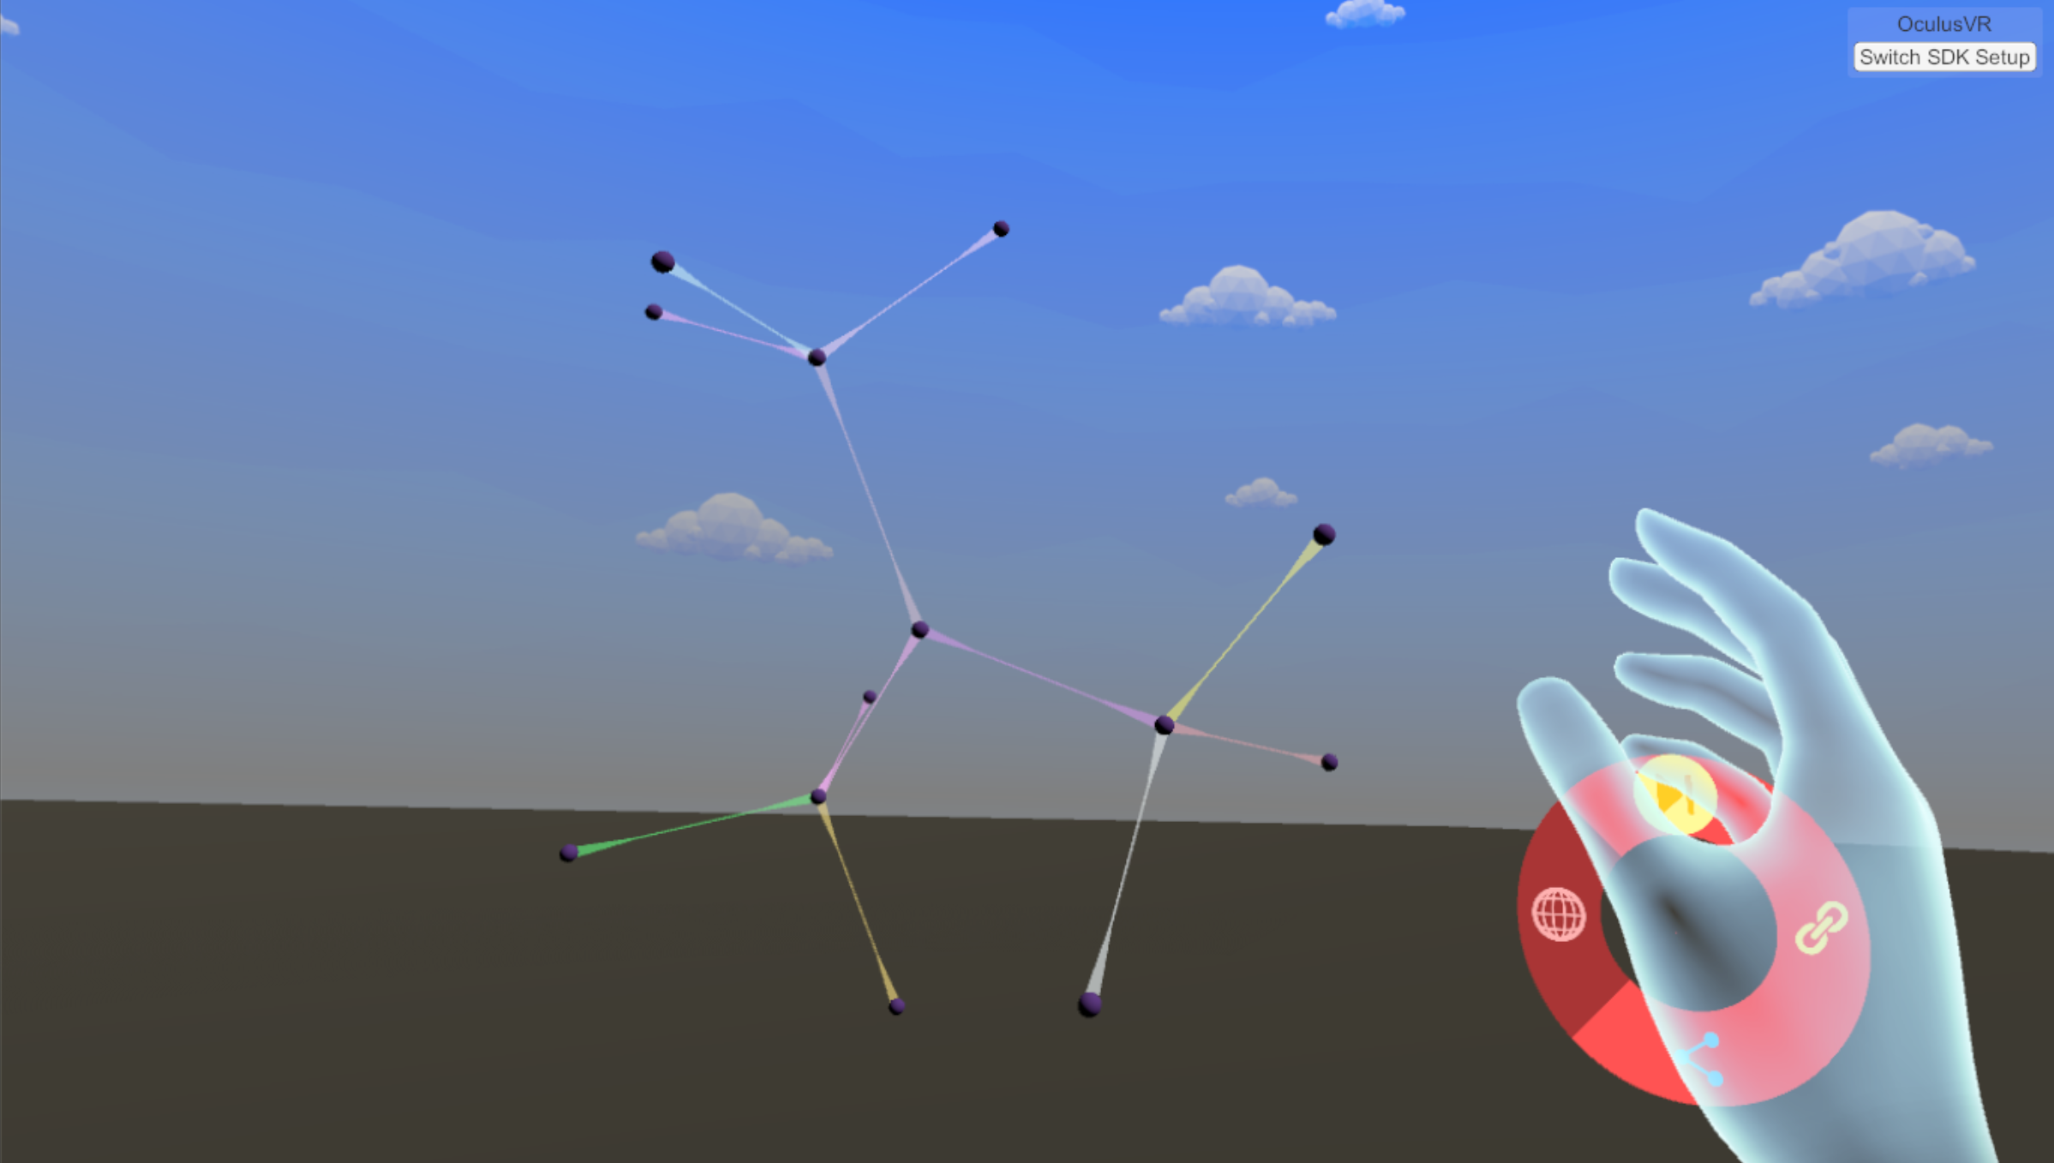
UNIFORM
NODAL
SCALING

Slide 8

DEGREE
CENTRALITY
NODAL
SCALING

Slide 9
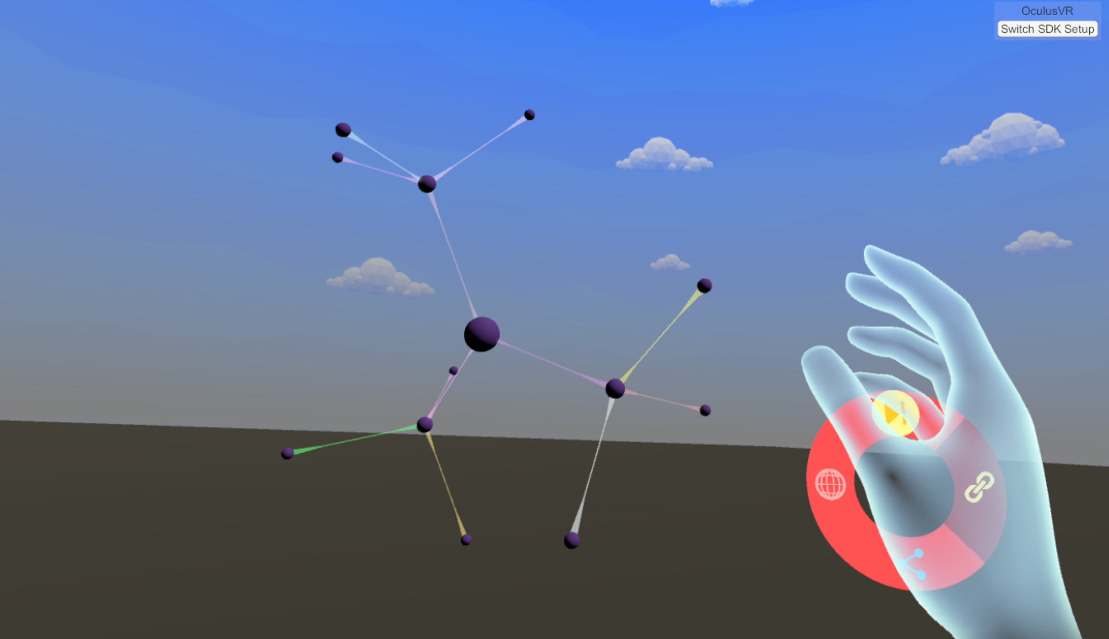
EIGENVECTOR
CENTRALITY
NODAL
SCALING

Slide 10
CAPABILITIES
GENERAL PURPOSE GRAPH CONTROLS
THROUGH MECHANICAL CONTROLS
PLANAR GRAVITY
CHANGE NODE SIZE
CHANGE GRAPH COLOURS
CHANGE FORCE DIRECTED LAYOUT PARAMETERS
FREEZE/UNFREEZE GRAPH
SAVE/LOAD

Slide 11
VR SICKNESS
WHAT IS IT AND HOW CAN WE PREVENT IT?
SIMILAR TO MOTION SICKNESS
SYMPTOMS
COPING MECHANISMS
VR DESIGN

Slide 12
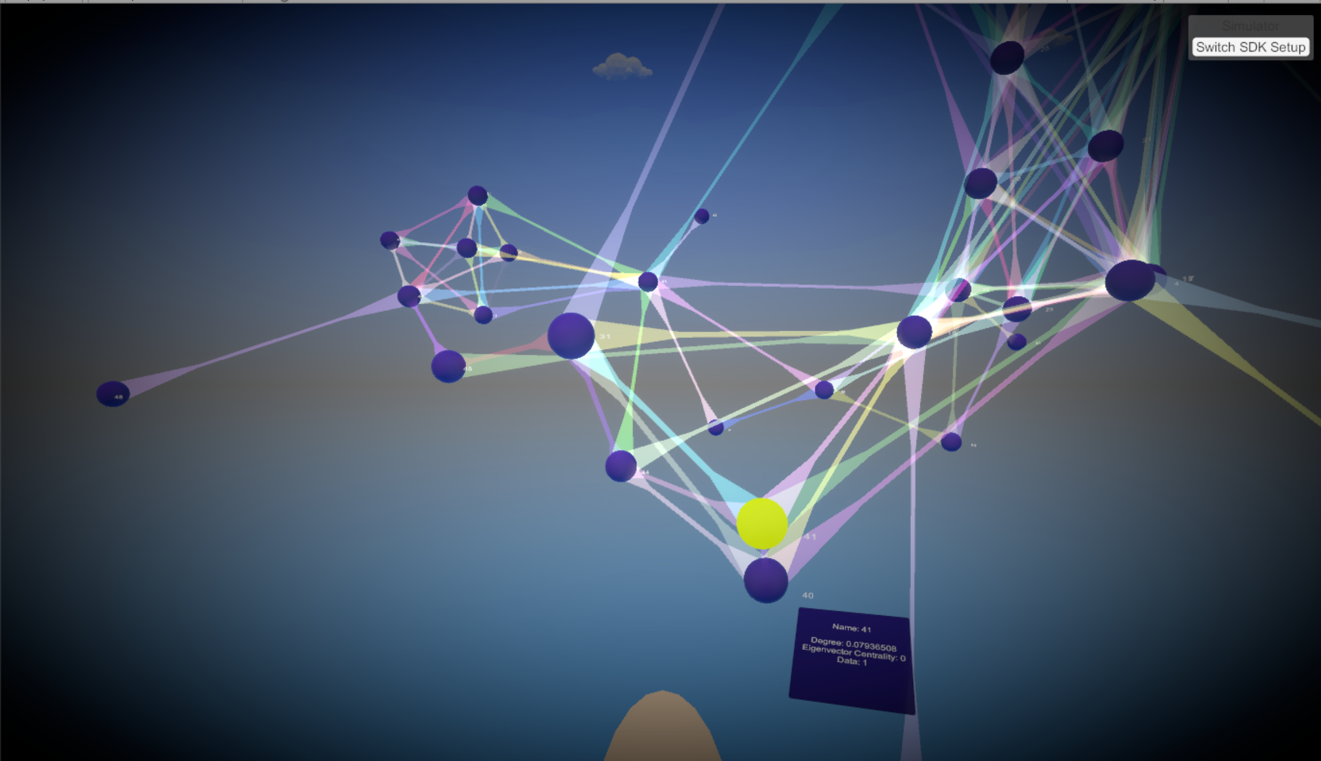

Slide 13
GAME
VACCINATION GAME
FOUR TYPES OF NODES: VACCINATED, HEALTHY, ANTIVAXXER AND SICK
PLAYER SELECTS A NUMBER OF NODES TO VACCINATE
A PATIENT ZERO APPEARS
EACH TURN CONSISTS OF ONE VACCINATION THEN DISEASE SPREAD
SCORED ON NUMBER OF SURVIVING NODES

Slide 14
CONCLUSIONS
WHAT HAS BEEN LEARNT FROM THIS PROJECT?
VR SICKNESS IS PROBLEMATIC
SUITED FOR SMALL GRAPHS
MECHANICAL INPUTS WORK WELL
VERTICAL MOVEMENT
ENJOYABLE EXPERIENCE

Slide 15
PRESENTATION AND SOURCE CODE AVAILABLE AT: HTTPS://GITHUB.COM/KEYANSN/FYP

